Slide 1
Visualizing Objects in Java
better than with toString()

Slide 2
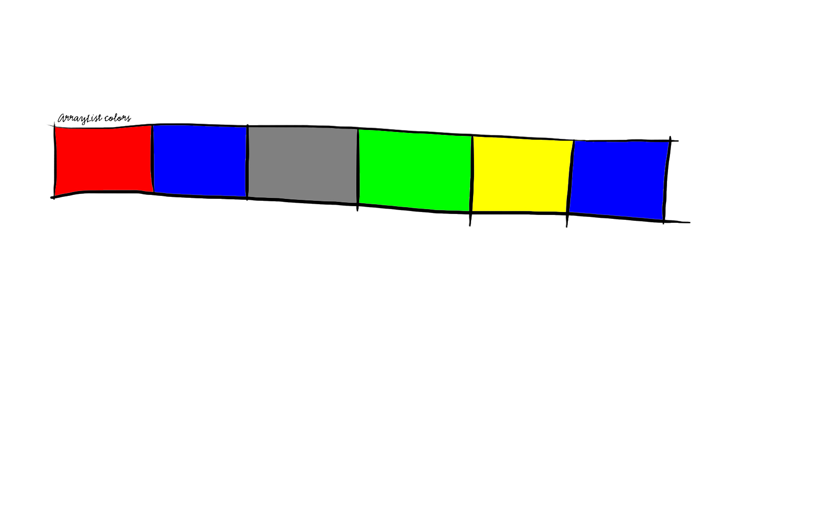
Why?
ArrayList containing some Colors
Console output (System.out.println(colors);):
[java.awt.Color[r=255,g=0,b=0], java.awt.Color[r=0,g=0,b=255], java.awt.Color[r=128,g=128,b=128], java.awt.Color[r=0,g=255,b=0], java.awt.Color[r=255,g=255,b=0], java.awt.Color[r=0,g=0,b=255]]
Possible graphical output (D.raw(colors);):

Slide 3
Comparison
Console:
[java.awt.Color[r=255,g=0,b=0], java.awt.Color[r=0,g=0,b=255], java.awt.Color[r=128,g=128,b=128], java.awt.Color[r=0,g=255,b=0], java.awt.Color[r=255,g=255,b=0], java.awt.Color[r=0,g=0,b=255]]
[java.awt.Color[r=255,g=0,b=0], java.awt.Color[r=255,g=0,b=255], java.awt.Color[r=128,g=128,b=128], java.awt.Color[r=0,g=255,b=0], java.awt.Color[r=255,g=255,b=0], java.awt.Color[r=0,g=0,b=255]]

Slide 4
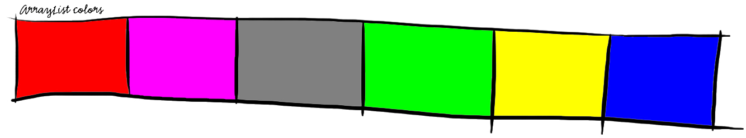
Comparison
Graphical:

Slide 5
Textual Visualization
System.out.println(anyObject);
anyObject.toString();

Slide 6
Graphical Visualization
System.out.println(anyObject);
D.raw(anyObject);
Doodler.draw(anyObject);
anyObject.toString();
anyObject.draw(Drawer d);
if defined

Slide 7
Overview
D.raw( );
draw method
Instructions
for Doodler
Doodler
Object

Slide 8
Doodler.draw(Object o)
// check if o.draw(Doodler d) exists
…
if (hasDrawMethod) {
o.draw(this);
} else {
// standard drawings for usual
// data types
}

Slide 9
Implementing a draw Method
For a "Game" Object:
public void draw(Doodler d) {
d.draw(players);
d.draw(scopeBoard);
d.drawSmall(curPlayer);
d.drawOuter(die);
}

Slide 10
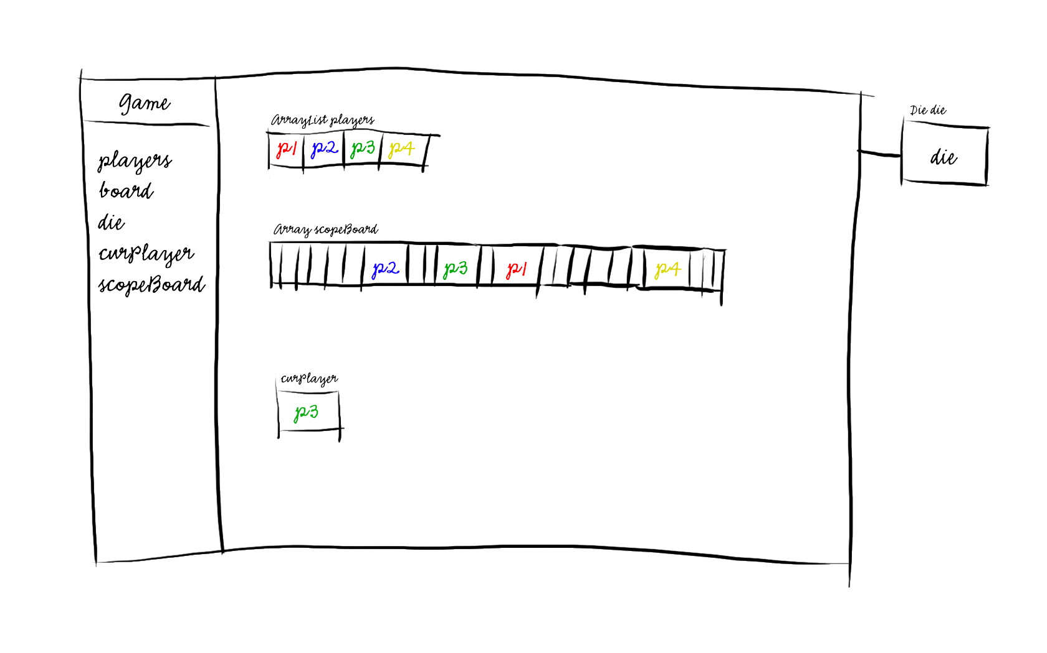
Style 1
public void draw(Doodler d) {
d.draw(players);
d.draw(scopeBoard);
d.drawSmall(curPlayer);
d.drawOuter(die);
}

Slide 11
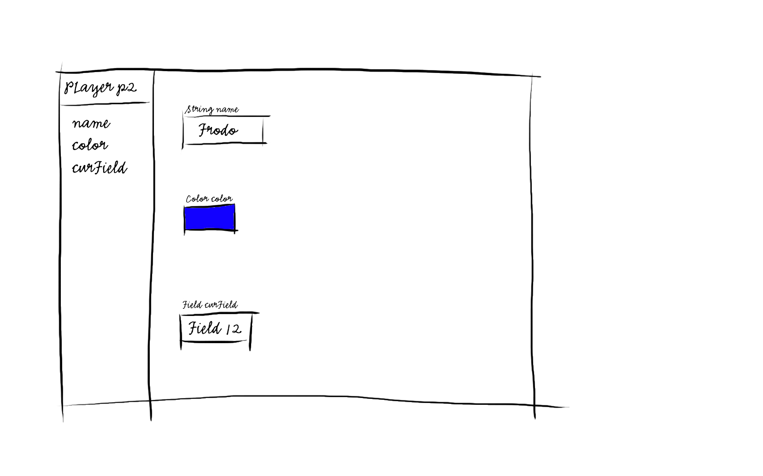
Style 1
D.raw(p2);

Slide 12
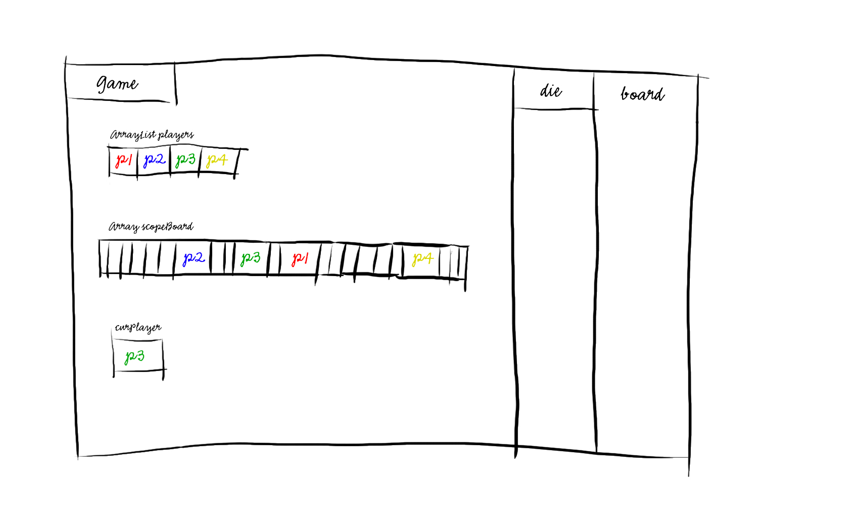
Style 2
public void draw(Doodler d) {
d.draw(players);
d.draw(scopeBoard);
d.drawSmall(curPlayer);
d.drawOuter(die);
}

Slide 13
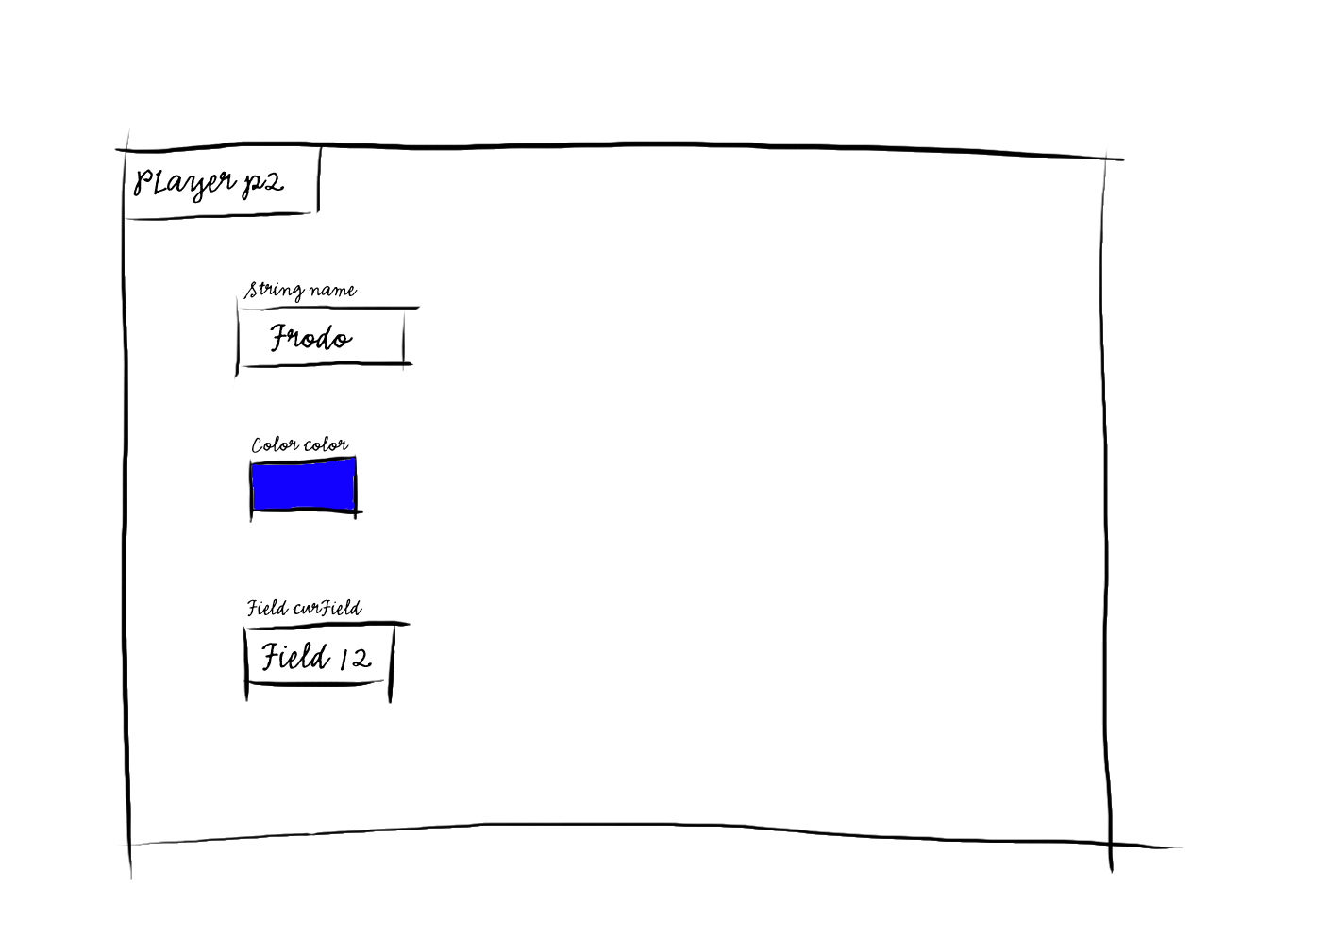
Style 2
D.raw(p2);

Slide 14
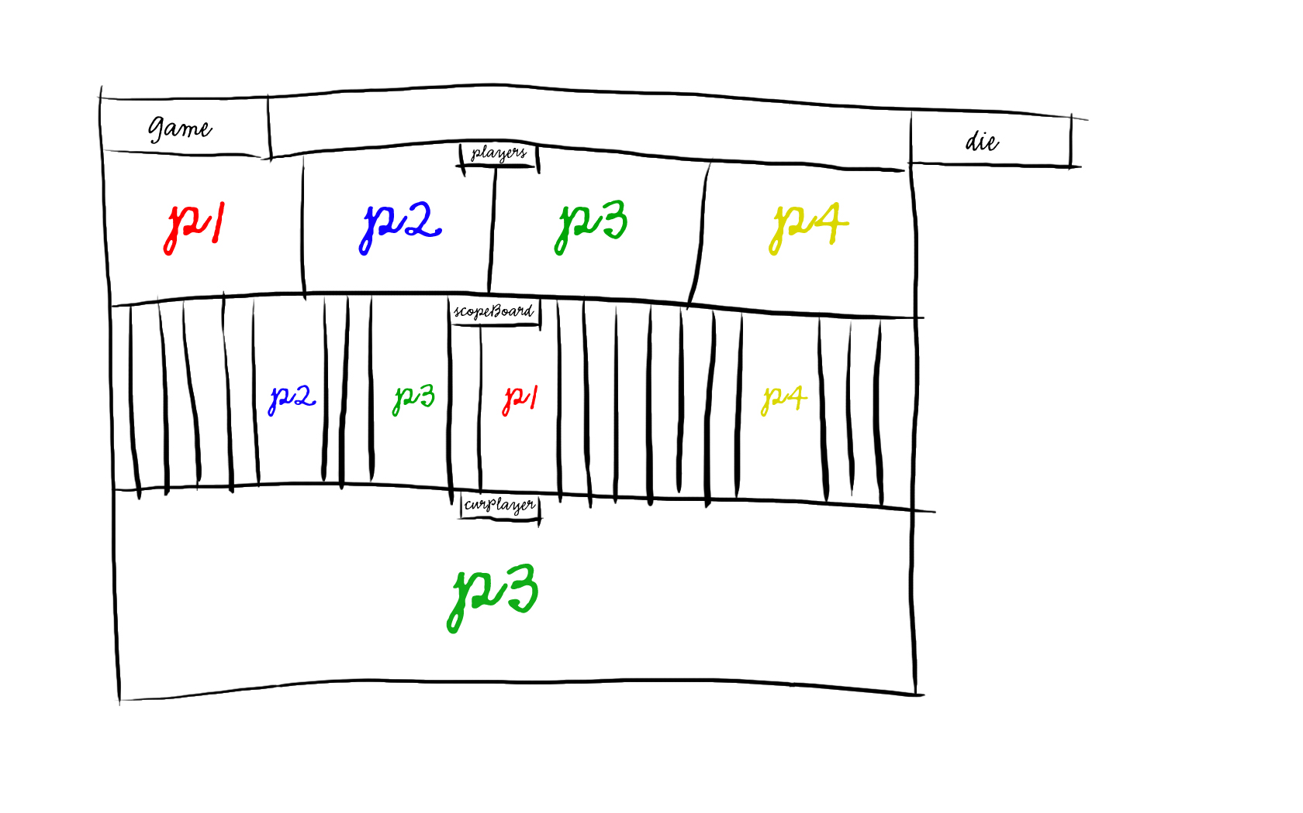
Style 3
public void draw(Doodler d) {
d.draw(players);
d.draw(scopeBoard);
d.drawSmall(curPlayer);
d.drawOuter(die);
}

Slide 15
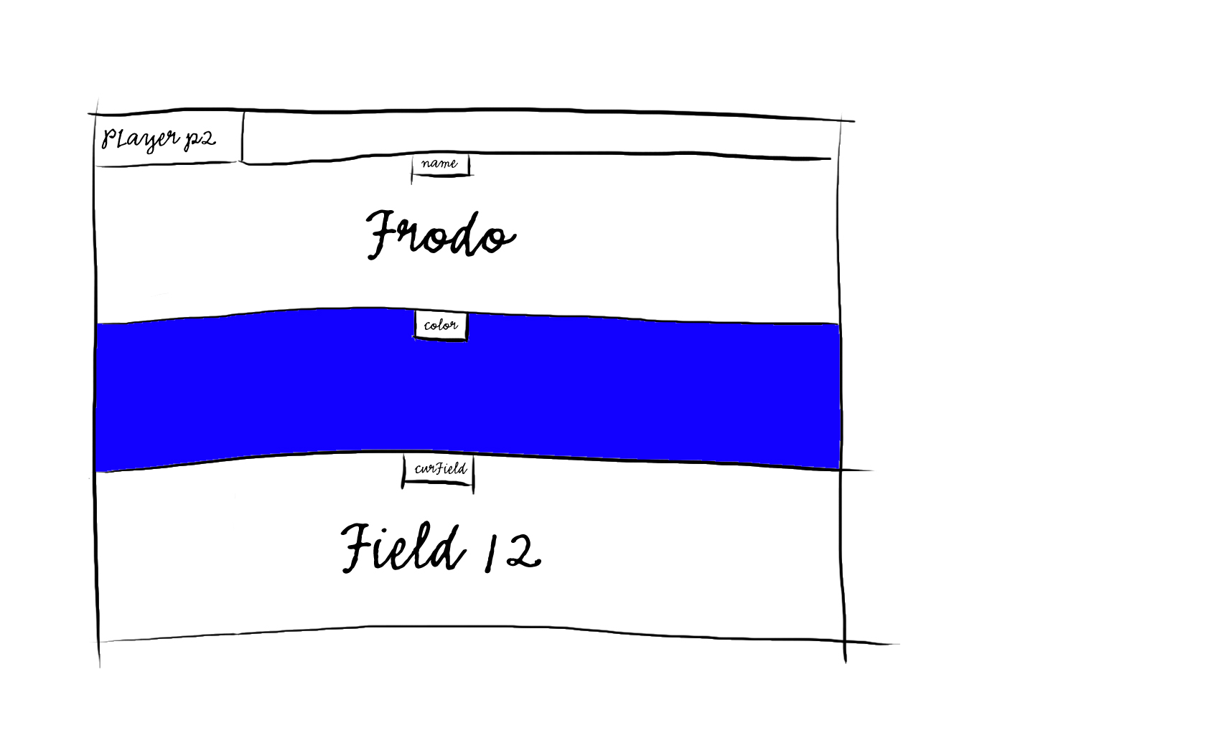
Style 3
D.raw(p2);

Slide 16
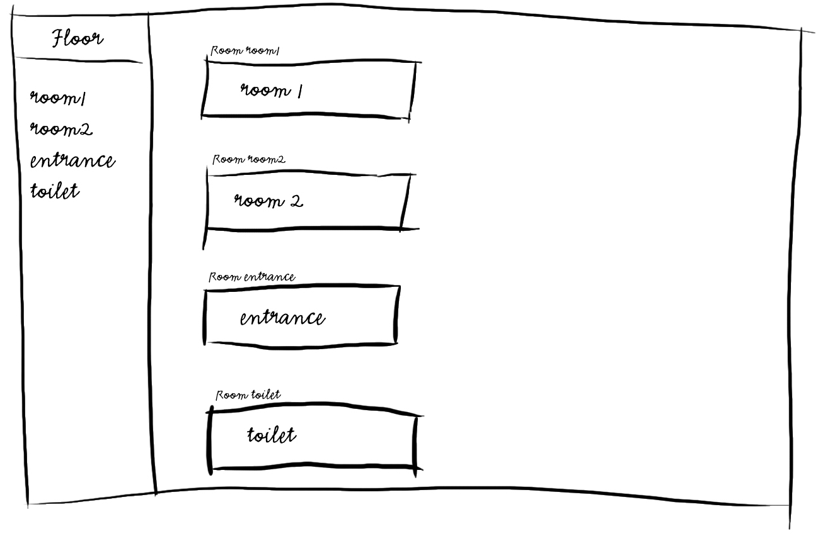
Possible Feature: Custom Mapping
D.raw(floor);

Slide 17
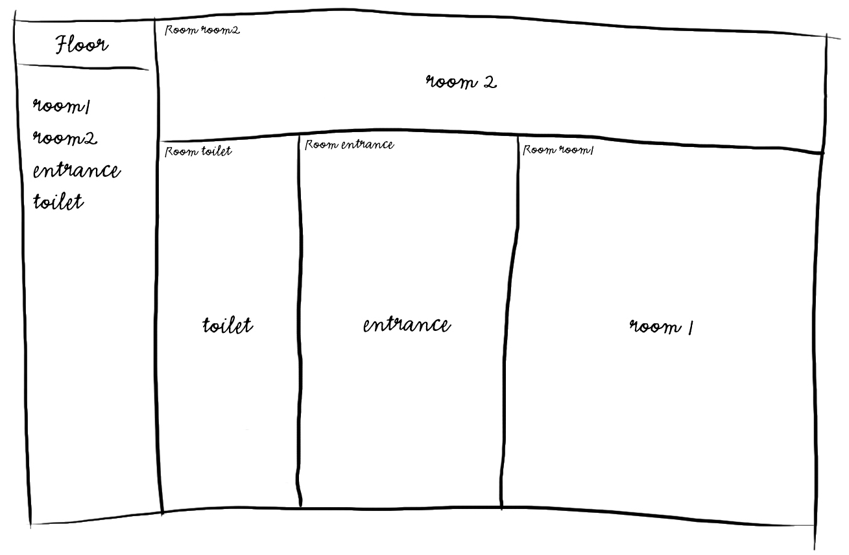
Possible Feature: Custom Mapping
D.raw(floor);

